Slide 1
Datathon Final Presentation
Michael David, Hemen Asfaw, Jake Soldera, Josh LaFronz

Slide 2
Introduction
Who are your stakeholders?
The owners of small, women-owned, and minority-owned businesses who secure an EPA contract award.
What problem are you trying to solve for the stakeholders?
While many businesses receive the maximum amount of money for an EPA contract, there are many that do not. How can a business owner ensure that they do not leave any money on the table?
How will you solve the problem?
We will search for variables that affect the probability of a small, women-owned, minority-owned business obtaining the maximum amount of money for an EPA contract.

Slide 3
Methodology
For this analysis, we examined the Environmental Protection Agency dataset sourced from the USA Spending Award Data Archive spanning from 2013 to 2023.
Analytics techniques:
We grouped the data into: Minority owned business, women owned businesses, both minority and women owned business, neither minority nor women owned business.
We analyzed these distinct groups with our explanatory variables in order to see how to obtain the maximum amount of money for EPA contracts.

Slide 4
Data Wrangling
One facet of the data set we like is that there is a great focus placed on who owns the businesses. This allowed us to easily tune our search for information about our specific target demographic.
One characteristic of the data set we wished was easier to deal with was the amount of missing data (NA). A more complete data set would have allowed us to obtain more accurate results.

Slide 5
Definitions
Minority Owned Business
A minority-owned business is one in which a minimum of 51 percent of the voting stock is owned and controlled by one or more minority group members. These groups include:
African/Black American
Hispanic American
Native American
Asian-Pacific American
Asian-Indian American
Woman Owned Business
A women-owned business is one in which a minimum of 51 percent of the voting stock is owned by one or more women.
Economically- disadvantaged individuals
Economically disadvantaged individuals are those whose ability to compete in the free enterprise system has been impaired due to diminished capital and credit opportunities.

Slide 6
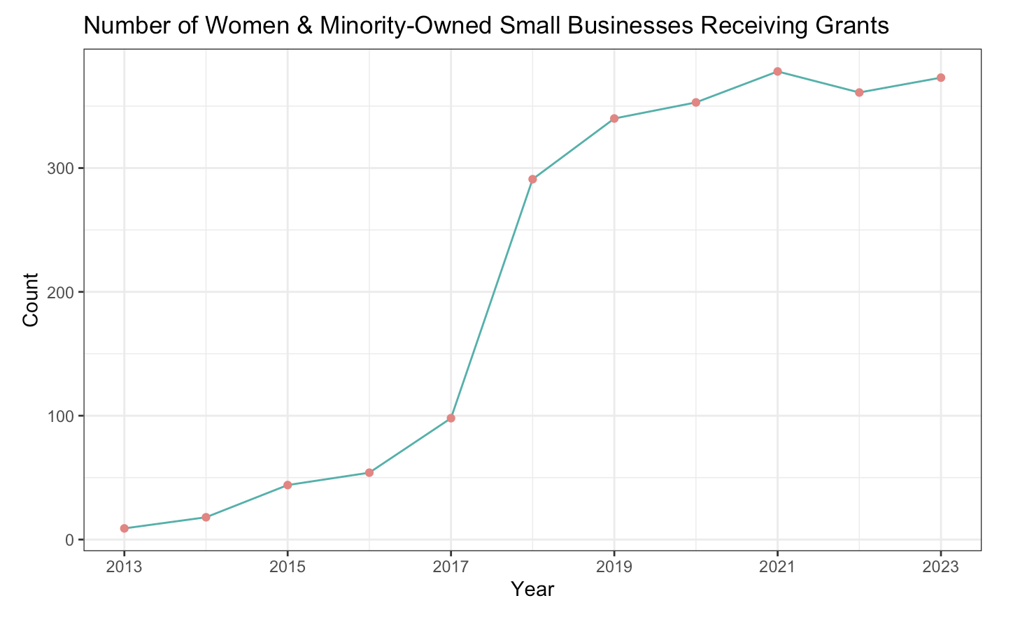

Slide 7
Variables of Interest
Variables used:
Potential total value of the award
Current total value of the award.
- The potential total value of the award represents the amount that could be obligated to a business if all contract options are exercised, whereas the current total value is the amount already obligated, regardless of unexercised options.
- By dividing the current value by the potential value, we determine the percentage of unclaimed funds, which our analysis seeks to reduce.

Slide 8
Insights
Potential explanatory variables:
Is the business a joint venture?
Is the business owned by an economically-disadvantaged person?
In which U.S. state is the business located?
Using these questions, we discovered the following differences between minority-owned, women-owned, and minority and women-owned businesses’ chances of obtaining the maximum grant.

Slide 9
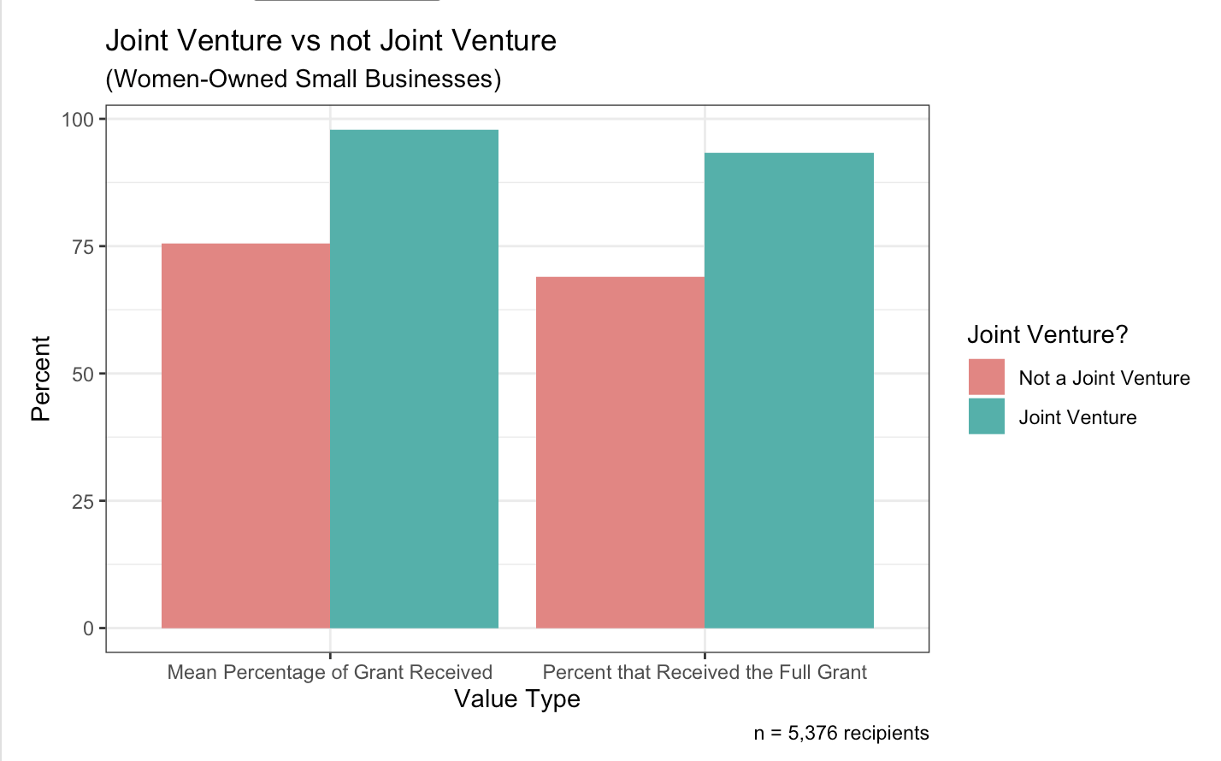
Joint Venture
As illustrated, we can see that women-owned small businesses have a higher mean percentage of grant received (nearly 100%) when they operate as joint ventures compared to when they do not (about 75%).
Similarly, for the percentage of businesses that receive 100% of the grant, those that are joint ventures exhibit a higher tendency to receive the full grant amount compared to those that are not joint ventures.

Slide 10
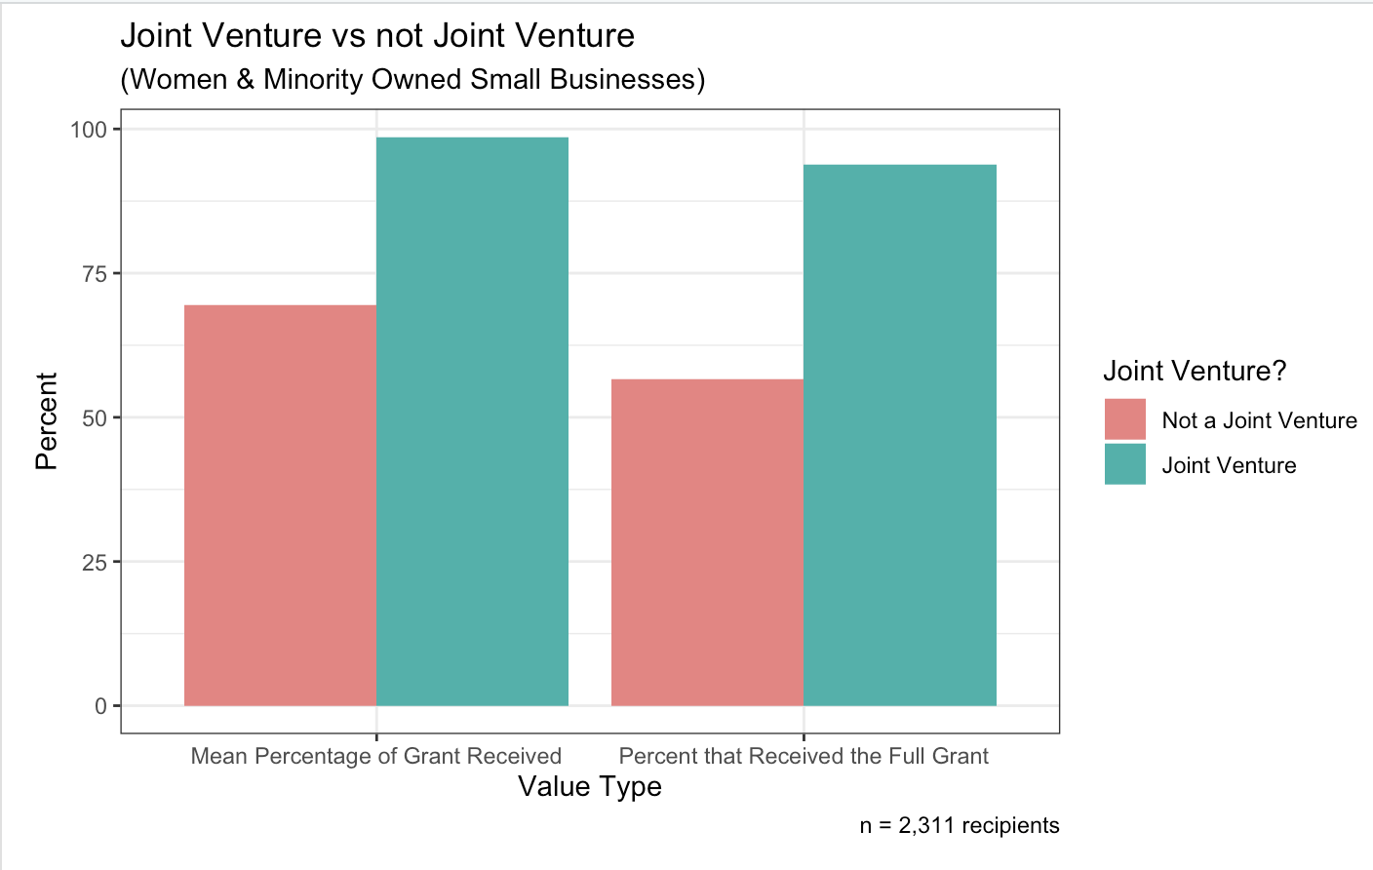
Joint Venture continued
There’s a noticeable contrast in the mean proportions of grants received by small businesses that are women and minority-owned, with joint ventures receiving significantly more grants compared to those that are not.
Additionally, joint ventures have a higher chance of receiving the full grant amount.

Slide 11
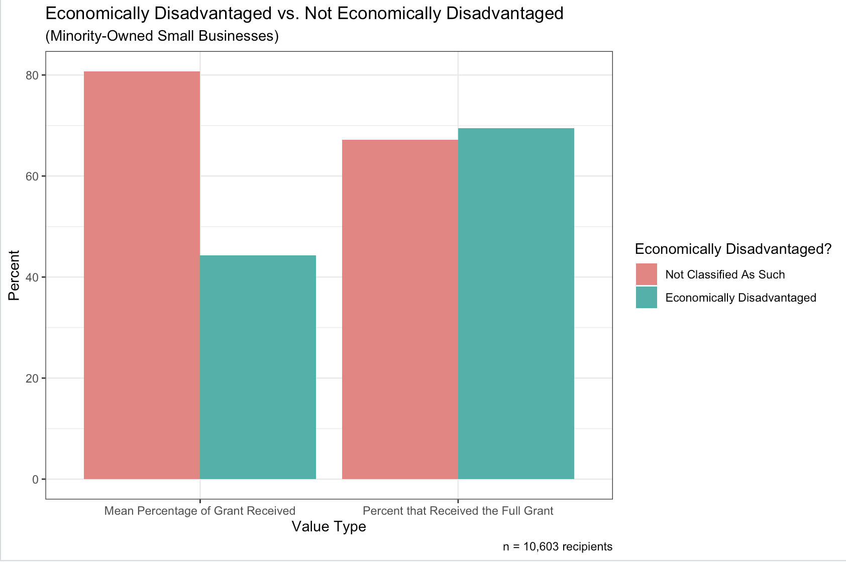
2. Economically Disadvantaged
We observe that small, minority-owned businesses classified as economically-disadvantaged typically collect a lower percentage of the grant (80% vs 44%).
There is little variation in the percentage earning the entire grant. The leftmost columns suggest a “feast of famine” nature of the grant money earned.

Slide 12
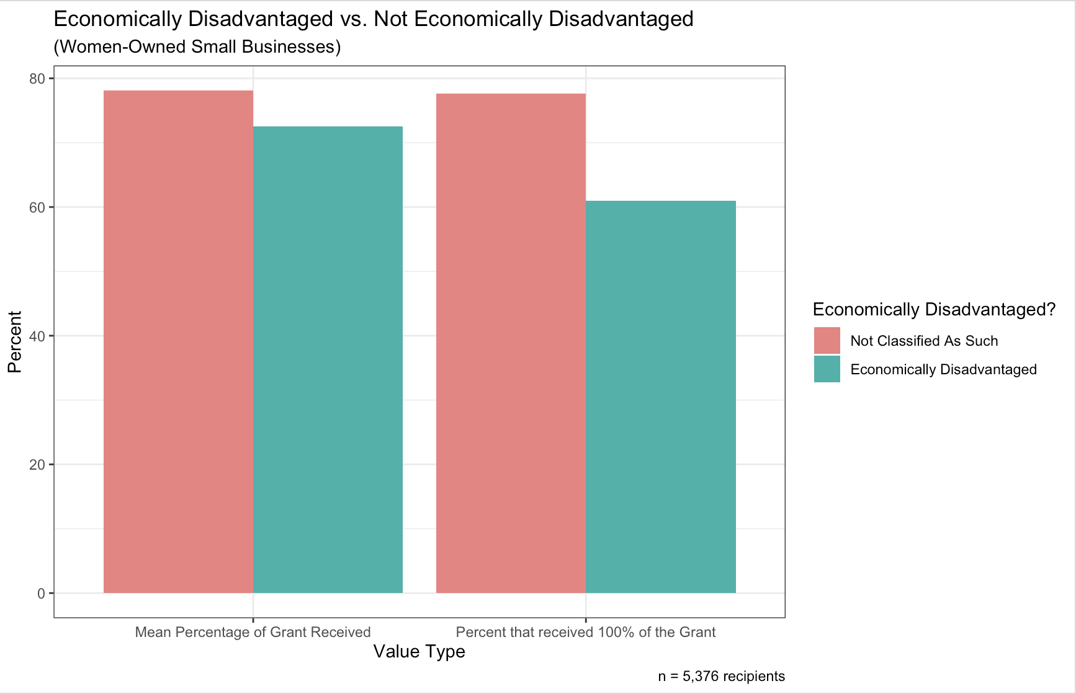
2. Economically Disadvantaged continued
Here, we note that small woman-owned business classified as economically disadvantaged receive more grants compared to economically disadvantaged ones.
Additionally, the businesses that are not classified as economically disadvantaged were about 16% more likely to receive the full grant.

Slide 13
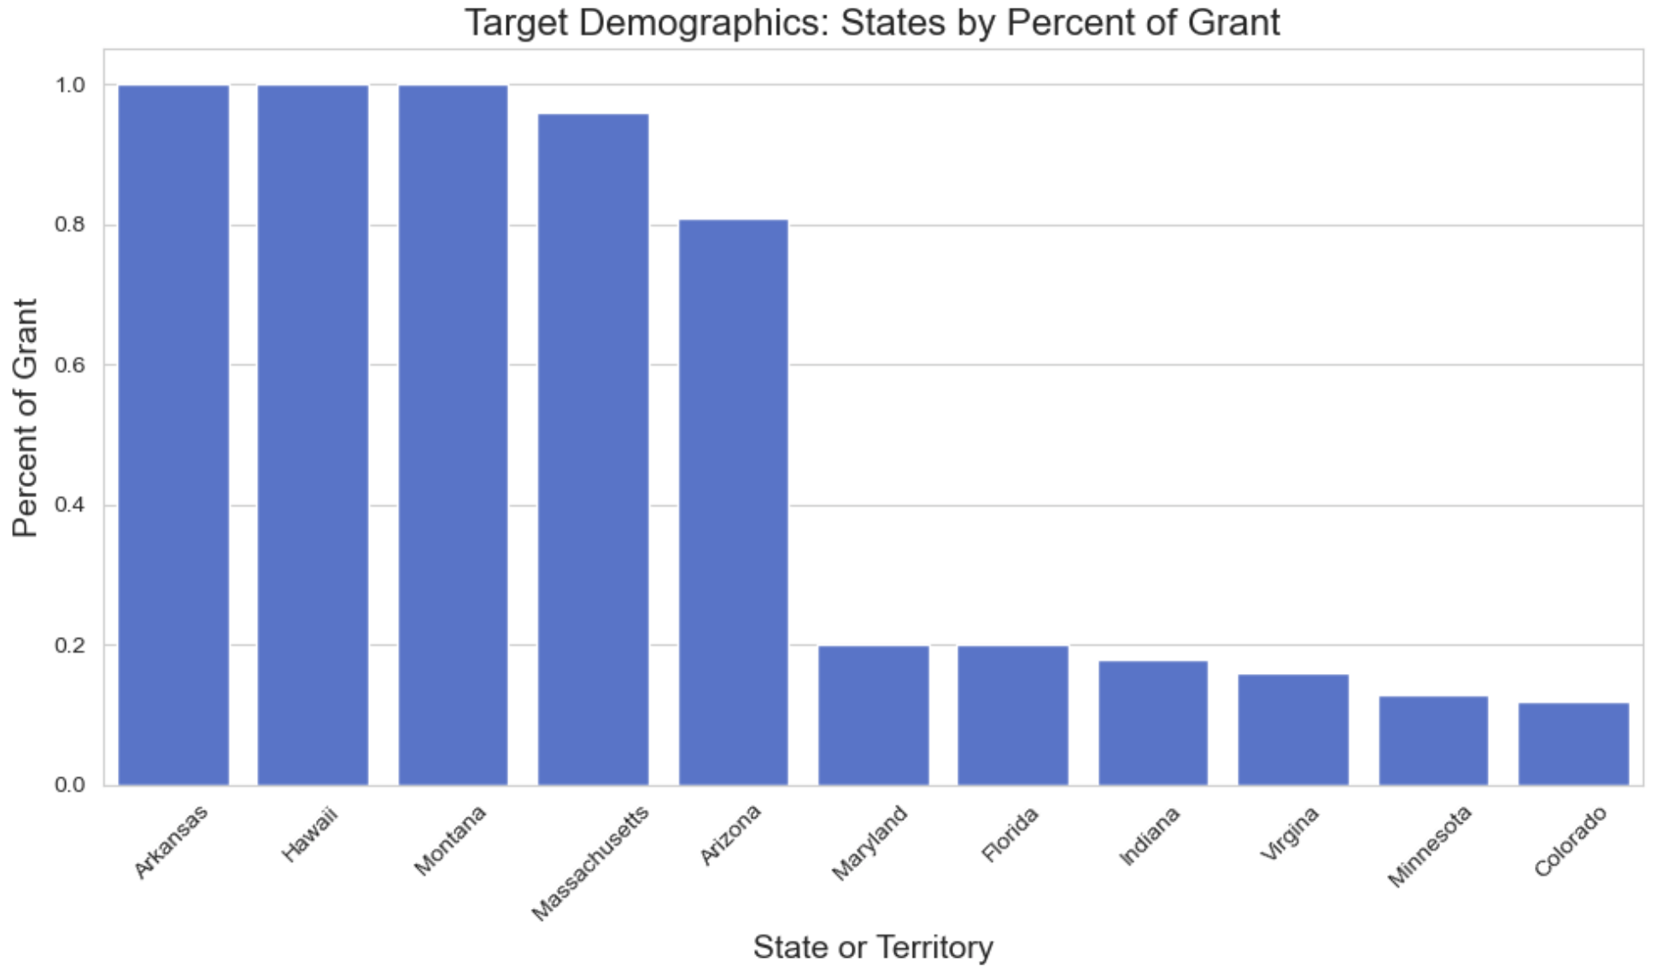
3. U.S. State or Territory
Top 5 favorable states and bottom 5 non-favorable states for our target demographics, small women and minority owned businesses, based on the average mean percentage of grants provided.

Slide 14
Recommendations
Based on our findings, our recommendation for a small, women-owned, minority-owned business to maximize the amount they obtain from an EPA contract award is the following:
Starting a business as a joint venture
Maximizing economic stability before starting a venture
Basing the business in a U.S. state with a high average EPA contract awards

Slide 15
Thank you!

